Slide 1
Introduction of Real-World Signals and Systems into ECpE DSP Laboratory Curriculum
Members:
Brady A. Max K.
Sam B. Emily L.
Mitchell H. Isaac R.
Team: SDDEC20-14
Advisor: Matthew Post
Client: Matthew Post Website: http://sddec20-14.sd.ece.iastate.edu/
Contact: Isaac Rex (irex@iastate.edu)
Notes:
Ren

Slide 2
Problem Statement
Conceptualizing the signals and systems curriculum at Iowa State University can be frustrating for new students.
The CyDAQ team seeks to redesign the signal processing laboratory curriculum using the CyDAQ teaching platform to help alleviate this frustration.

Slide 3
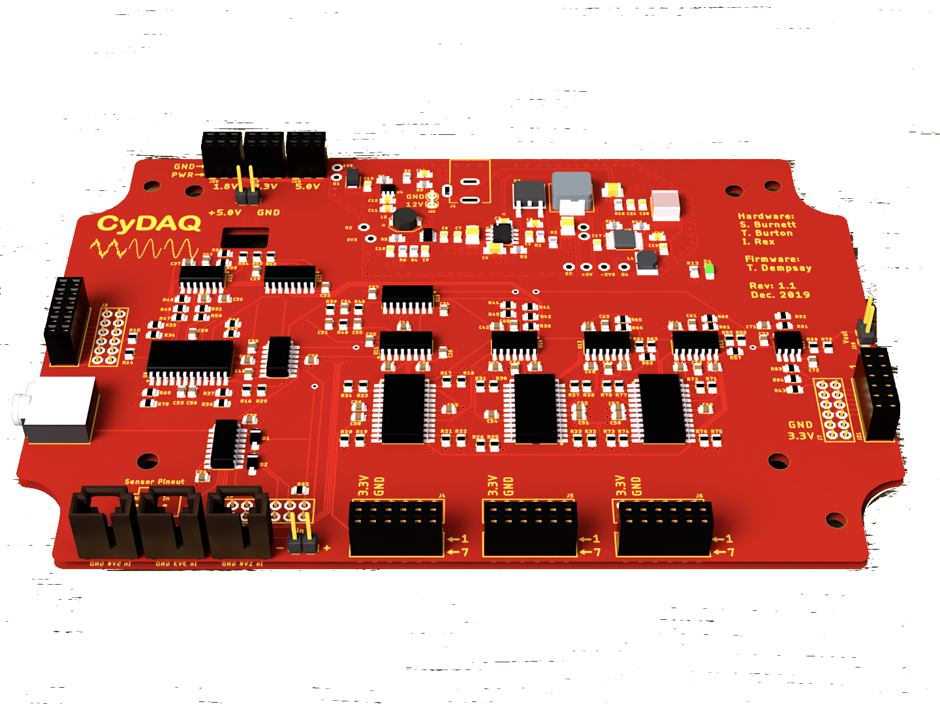
Introduction to CyDAQ
CyDAQ is a hardware teaching platform designed for EE 224/324 that contains onboard analog filters and interfaces for sampling data to a PC.
Our goal is to design labs and supplemental hardware that connect core concepts to real world hardware.
Figure 1: CyDAQ Board
Notes:
Max -
My name is Max, I am studying EE.
The CyDAQ is a hardware teaching platform, that was designed with the Iowa State Universities Electrical and Computer Engineering Dept. in mind.
Specificlaly, we spent our time targetting the curriculum for EE 224 and EE 324.
Complete set of low pass, band pass and high pass filters that are used for processing singals, as well as a interface for sampling data to a PC.
After reflecting on our own experiences we felt that EE 224 and EE 324 would be great candidates to update the labs and utilize the CyDAQ platform. The purpose of the CyDAQ is to bridge the gap between the technical core concepts and real world applications in lab. We are doing this by putting a CyDAQ in the hands of students during lab time as well as implementing brand new labs in EE 224 and EE 324 to utilize the CyDAQ platform.

Slide 4
Conceptual Sketch
CyDAQ
Software/Firmware
Hardware
Labs
Embedded
Signal Routing
EE 224 & 324
Graphical Interface
Sampling
Learning Objectives
FPGA
Band-limiting
Real-World Application

Slide 5
Project Timeline
Spring 2019
Fall 2019
Spring 2020
Fall 2020
Requirements Defined, Analog Filters Redesigned
Platform Hardware Redesign
Lab Design,
Software Development
Hardware Expansion,
Lab Implementation
Functional design and validation of filters
State variable filter
Digital control scheme
Design and validation of power delivery
Sensor interfaces
Full I/O definition
Mechanical definition
Curriculum integration
User interface design
Platform firmware
Control flow development
Expanded functional requirements
Final hardware revision
Finalize Firmware/GUI
PMOD expansion development
Lab document delivery
Notes:
SAM

Slide 6
Goals
Create and submit lab documents for EE 324 and EE 224
EE 224 Final Project
4+ Labs for EE 324
Final CyDAQ hardware revision
Expand sampling bandwidth with SPI differential ADC
Add SPI DAC to broaden application potential
Revise FPGA firmware to utilize FreeRTOS parallel processing
Notes:
Brady

Slide 7
Technical Challenges
Hardware:
Speed requirements and throughput of FPGA and ADC
Design and PCB layout for 3MHz ADC front
Designing novel, robust board expansions to compliment labs
Software:
Implementing robust serial protocol for front end communication with CyDAQ
Updating current firmware to FreeRTOS implementation
Notes:
Ren

Slide 8
Technical Challenges, cont.
Lab Documents:
Balancing technical knowledge with fun, challenging designs
Connect lecture to real-world applications while keeping experiments at an appropriate difficulty level
Including textbook theory without overwhelming students with long documents and technical language
Create a cohesive transition from EE324 to multiple focus areas (Power, Communications, Controls, and Signal Processing)
Notes:
Ren

Slide 9
Summary:
Complete, expandable hardware solution
Polished, robust software delivery
Intuitive set of labs using CyDAQ hardware to cement abstract theory
Thank you for listening!
Questions? Contact us at sddec20-14@iastate.edu

